Slide 1
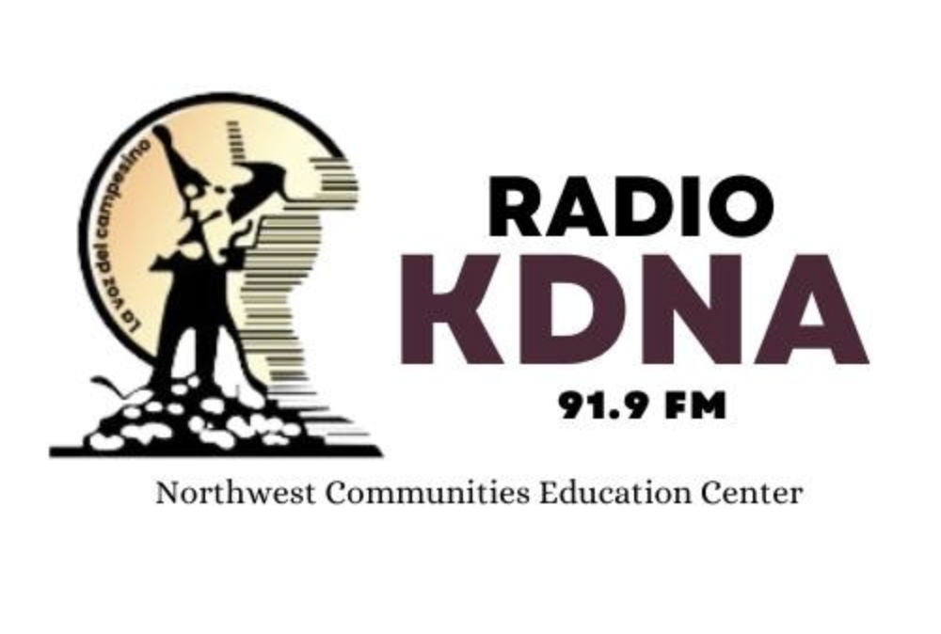
Best Practices for Opioid Awareness: Radio and Outreach Campaigns
Elizabeth Torres, Director of Operations
Salvador Delgadillo, Program Coordinator

Slide 2
Mission/Vision
As a noncommercial educational public radio station, we aim to address cultural and informational isolation of Hispanic/Latino Americans and other disadvantaged communities.
Produce quality radio programming to overcome barriers of literacy, language, discrimination, poverty, and illness. ​
Empower communities to participate fully in a multiethnic society.
Uplift future generations through education and engagement.
Notes:
Northwest Communities Education Center/ Radio KDNA
A non profit organization 501©3
With it’s a noncommercial educational public radio station, we aim to address the cultural and informational isolation of Hispanic/Latino Americans and other disadvantaged communities.
Produce quality radio programming to overcome barriers of literacy, language, discrimination, poverty, and illness. ​
Empower communities to participate fully in a multiethnic society.
Uplift future generations through education and engagement.
NCEC/KDNA applies for grants to support that work to address issues important to our community and help fund projects like resource fairs, brochures, books, workshops, national night outs, our news programs from our radio station.​

Slide 3
How did it all start?
Dec 19, 1979: NCEC launched a Radio KDNA Spanish-language noncommercial education public radio station
May 18,1980: Mount St. Helens eruption
September 21, 1986: We covered and helped with "the Movement" the first strikes led by the United Farm Workers of Washington State. ​
1986: Amnesty
1986: HIV AIDS
March 2020 Covid-19 pandemic ​
We strive to bring education and entertainment on a daily basis to our listeners through our radio programs.
Notes:
1976, NCEC incorporated as a nonprofit 501c3
1979, The Northwest Communities Education Center launched Radio KDNA a Spanish-language noncomercial educational public radio station in the heart of the Yakima Valley, located in Eastern Washington. The first Public Radio Station ​ 24 hours 7 day a week in Spanish in the Northwest
Radio KDNA since then has cover and provided information to the community an some of the major events had been
May 18, 1980 We were able to help the Spanish-speaking community when Mount St. Helens erupted. ​
September 21, 1986 We covered and helped with "the Movement" the first strikes led by the United Farm Workers of Washington State on September 21, 1986 and achieved their first agricultural contracts on December 5,1995. ​
In 1986 during the Amnesty -Radio KDNA was instrumental in getting farm workers to establish their immigration status. ​
1986 when HIV-AIDS stated KDNA developed one of the firs series of fotonovelas tres hombres sin fronteras –CPB award wining materials
Covering and helping with the Covid-19 pandemic in March 2020.​

Slide 4
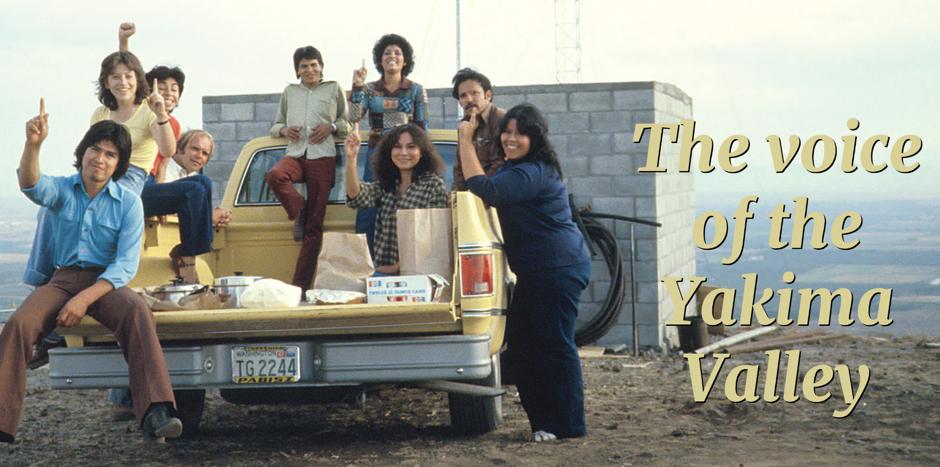
KDNA Audience
Yakima Valley
Generational farmworkers
Primarily Hispanic/Latino
Spanish as a first language
Undocumented
Underserved
Notes:
45 years serving the Yakima valley Spanish speaking community

Slide 5
Hispanic/Latinos prefer Radio as a primary media source
Easy access
Free
Flexibility
Reach
Language
Literacy levels
Community feedback
Notes:
Geographical reach
Public Radio continues to be an effective way to reach the Latino community in the Yakima Valley. With a wide reach and immediate delivery, public radio allows organizations, businesses, and government agencies to project their message in front of targeted, yet large audiences.

Slide 6
A Fountain of Community Resources Through the Radio
Educational services
Health
Housing support/ Assistance
Emergency
Legal
Notes:
Public Radio is an important platform that keeps the community informed and up to date with critical information that can impact the health and well-being of its audience.
In topic such education services, health,

Slide 7
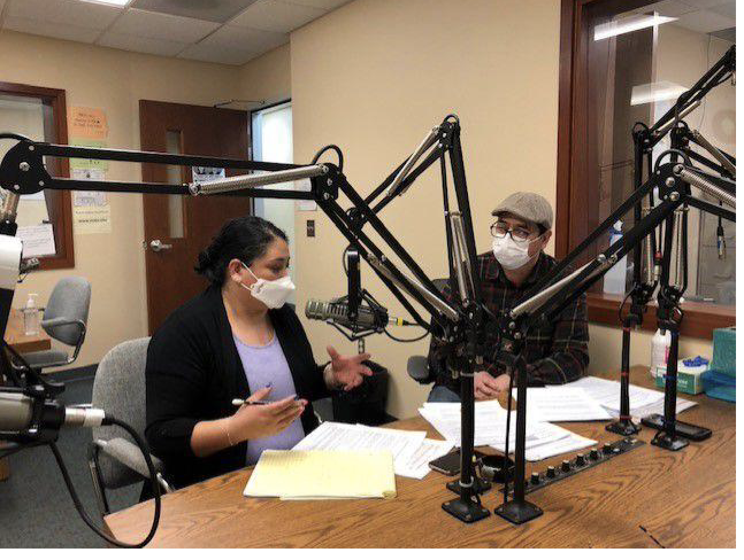
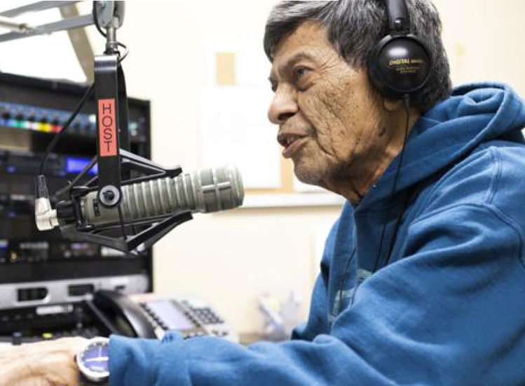
Public Radio
Amanecer Ranchero
Live Morning News
Oportunidades de empleo/ Job opportunities​
El Jardin de los niños/ The children’s garden​
Cambalache/ Swap Meet​
Aqui y Alla/ Here and There​
Temas de Opioides/ Opioids topics​
Temas del Covid-19/ Covid-19 topics​
Saludos musicales/ Musical greetings
Notes:
Talk about the Radio program's purpose and or which audience some of the promgrams reach
Amanecer Ranchero- lifely music when the farmworkers are going to work
News – segment – cover current local, state, reginal, national and intenation news that affects the community

Slide 8
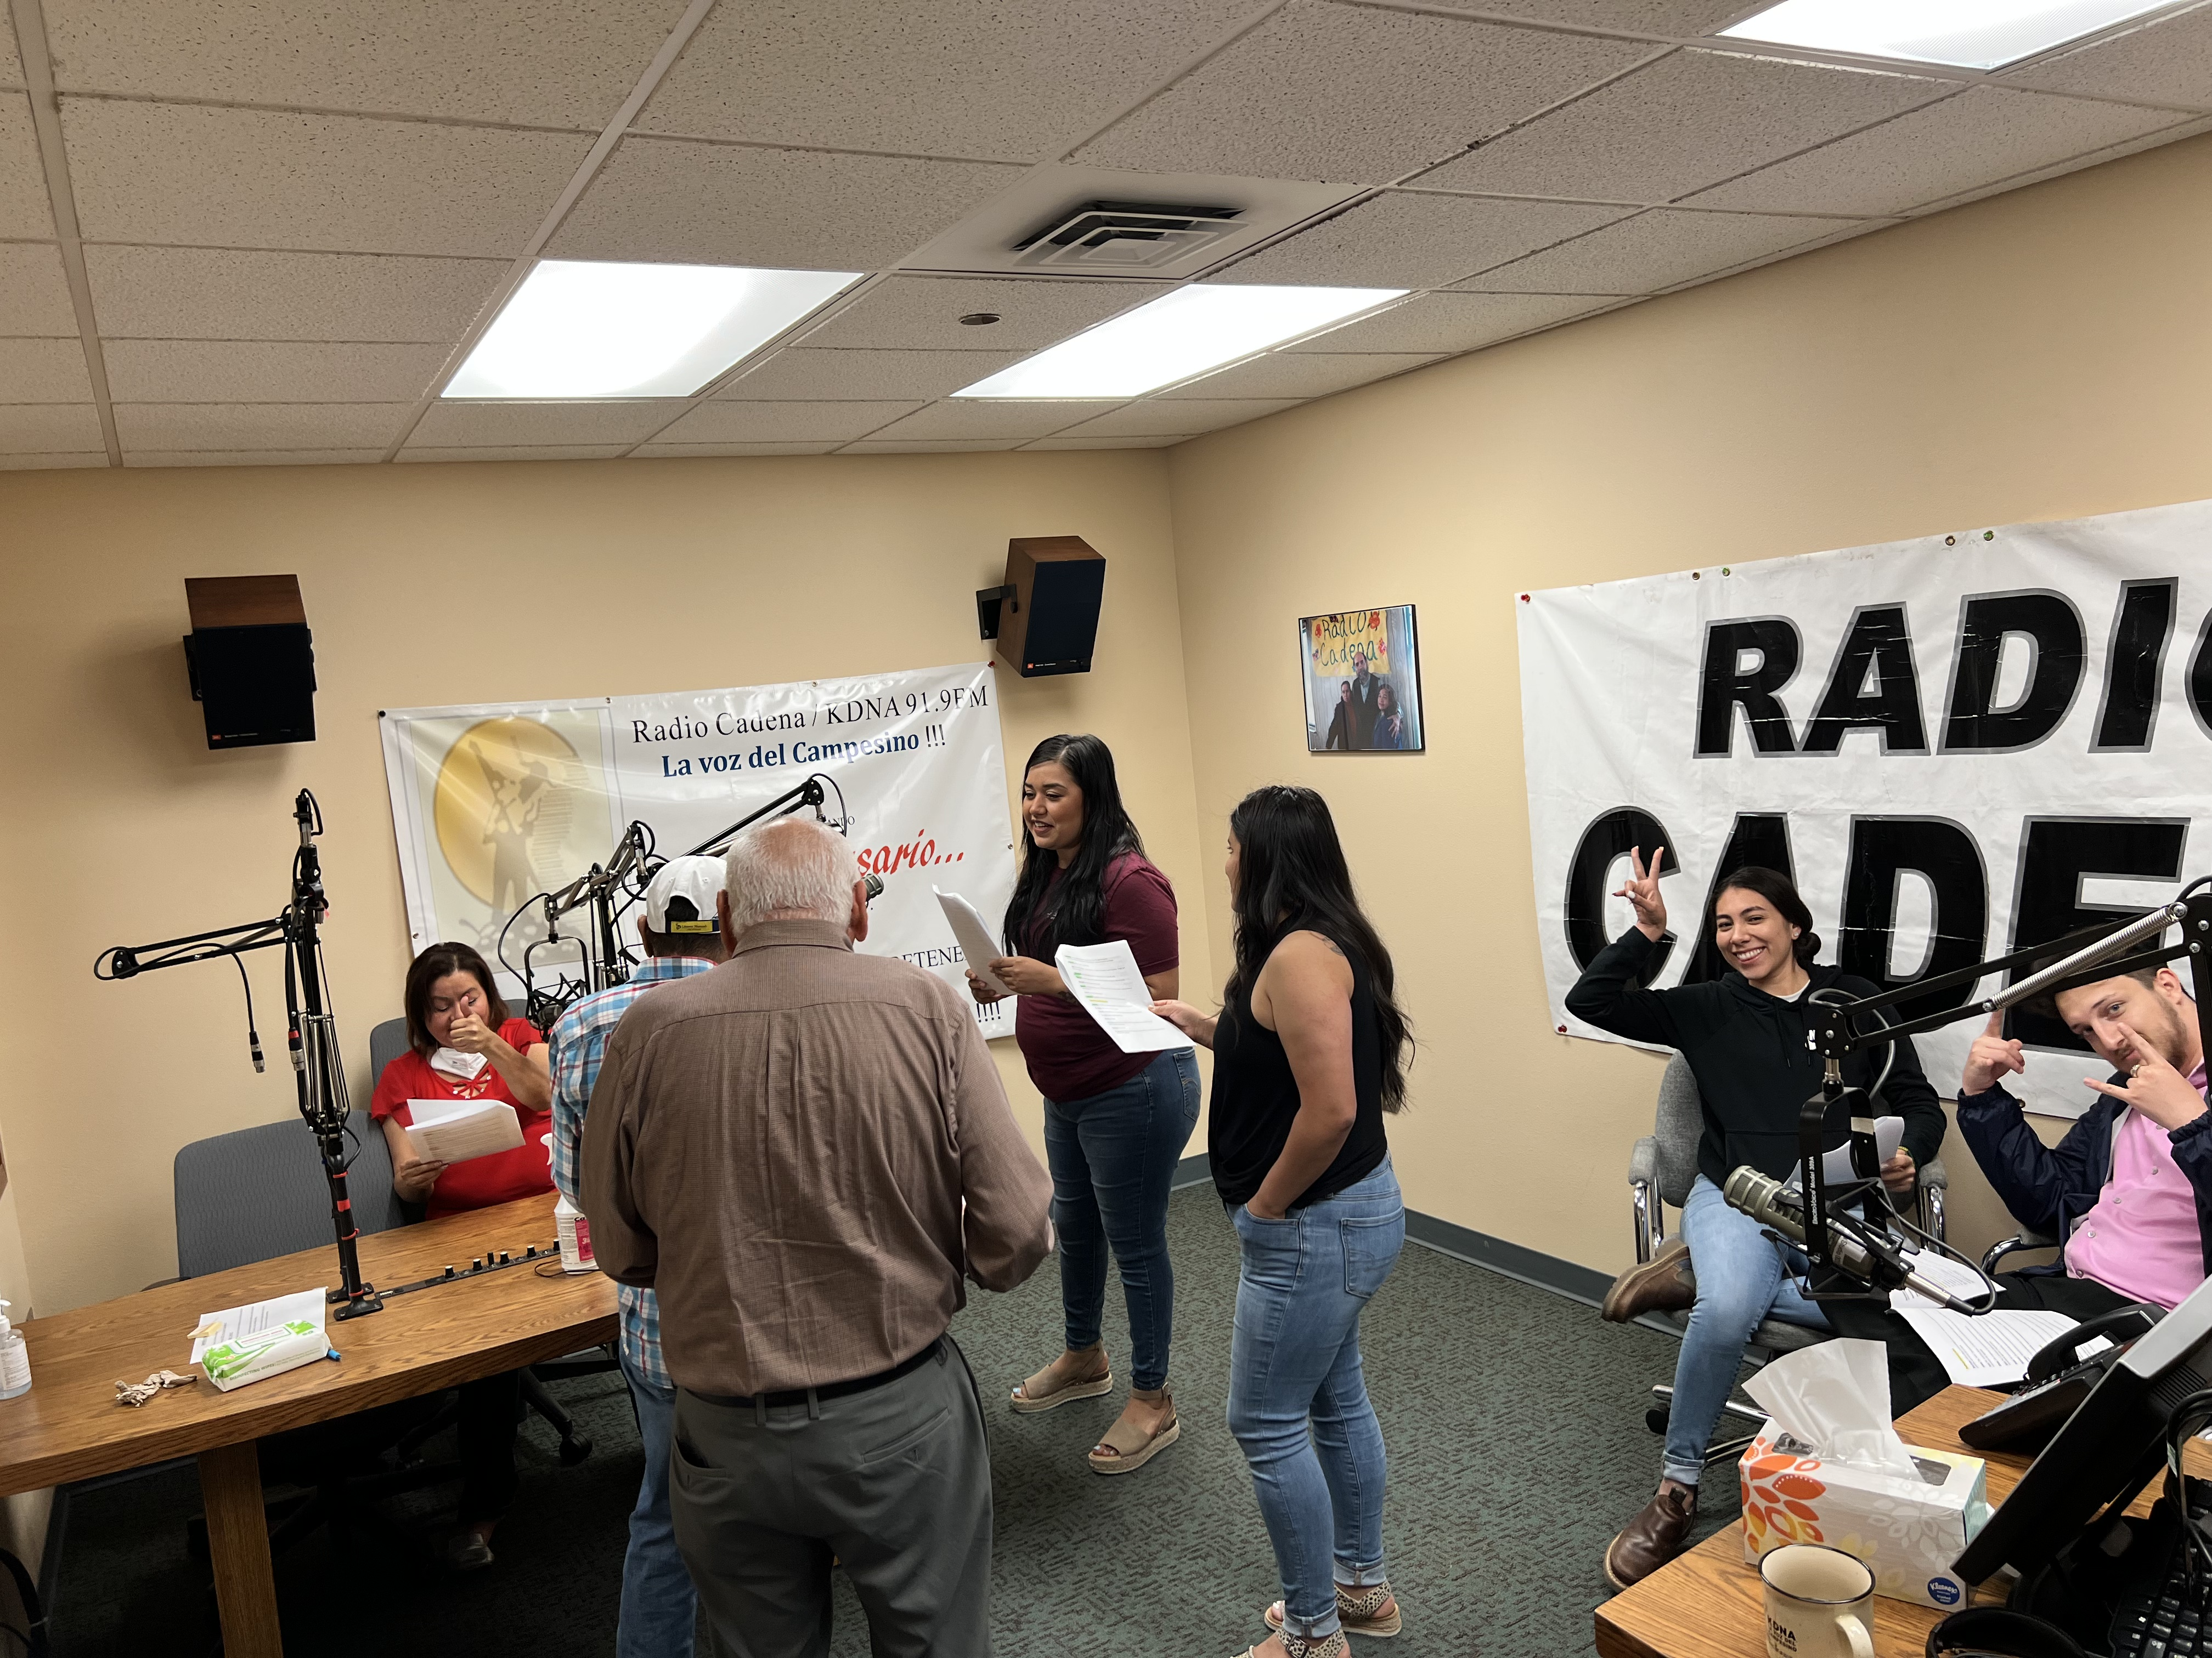
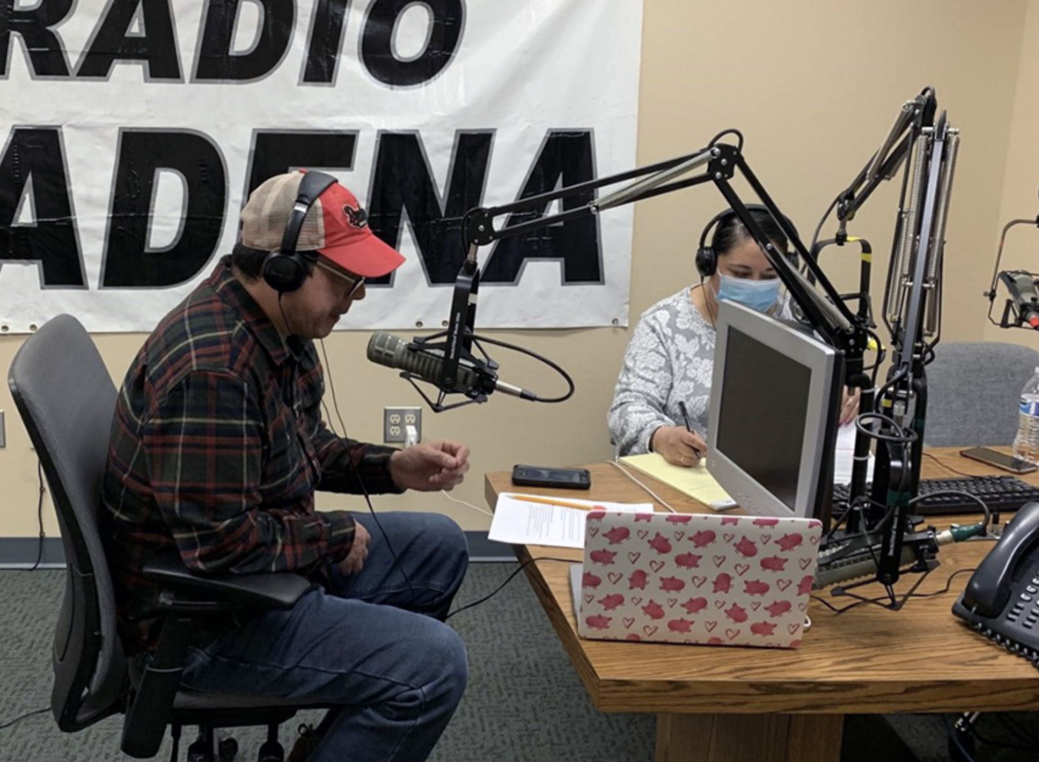
Radio Outreach productions
Informational Capsules
News Segments
Radio Novelas
PSA’s
Live radio interventions
One Hour Public Affairs Programs
5 to 10 minutes interviews
Notes:
When developing a Radio Campaign
Needs to consider to produce and development
Informational capsules 30 to 60 second information segments
2 to 3 minutes interviews or segment during the news
3 to 5 minutes radio drama
We use all this deferent outreach materials to bring information to the community primarily farmworker community

Slide 9
Opioids Prevention Project
Goal: To reach underserved populations who may have limited literacy and who may experience cultural and informational isolation, to address prevention, education, and treatment for opioid users or those at risk for opioid use.
Create a Radio Media campaign to address opioid overdose on prevention
Host four workshops on opioid use and prevention
Host two conferences on opioid use prevention
Notes:
In December 2019 received funding from the Department of Health for the Opioids Prevention Project
Goal: To reach underserved populations who may have limited literacy and who may experience cultural and informational isolation, to address prevention, education, and treatment for opioid users or those at risk for opioid use.
Create a Radio Media campaign to address opioid overdose on prevention
Host four workshops on opioid use and prevention
Host two conferences on opioid use prevention

Slide 10
Eastern Washington Opioids Consortium
Sunnyside School District
Granger School District
Pacific Northwest University
Yakima Neighborhood Health Services
ESD 105
Department of Corrections
Inspire Development Centers
Sunnyside Unidos/United
Yakima Health District
Yakima Valley Farm Workers Clinic
Prosser Hospital
Notes:
To accomplish our goals, we started an opioids consortium with over 35 partners came together to support and provide guidance to the project

Slide 11
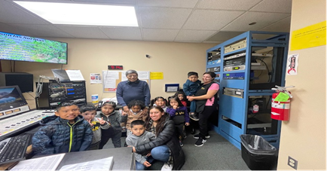
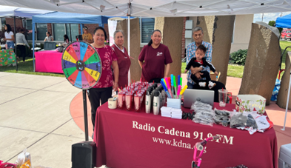
Radio Campaign
Produce one-hour public affairs programs
Develop informational capsules that pinpoint opioid misuse, awareness, treatment, and education for the community.
Produce a Radio Novela and air the radionovela
Notes:
The Radio campaign included
Produce one-hour public affairs programs
Develop informational capsules that pinpoint opioid misuse, awareness, treatment, and education for the community.
Produce a Radio Novela and air the radionovela

Slide 12
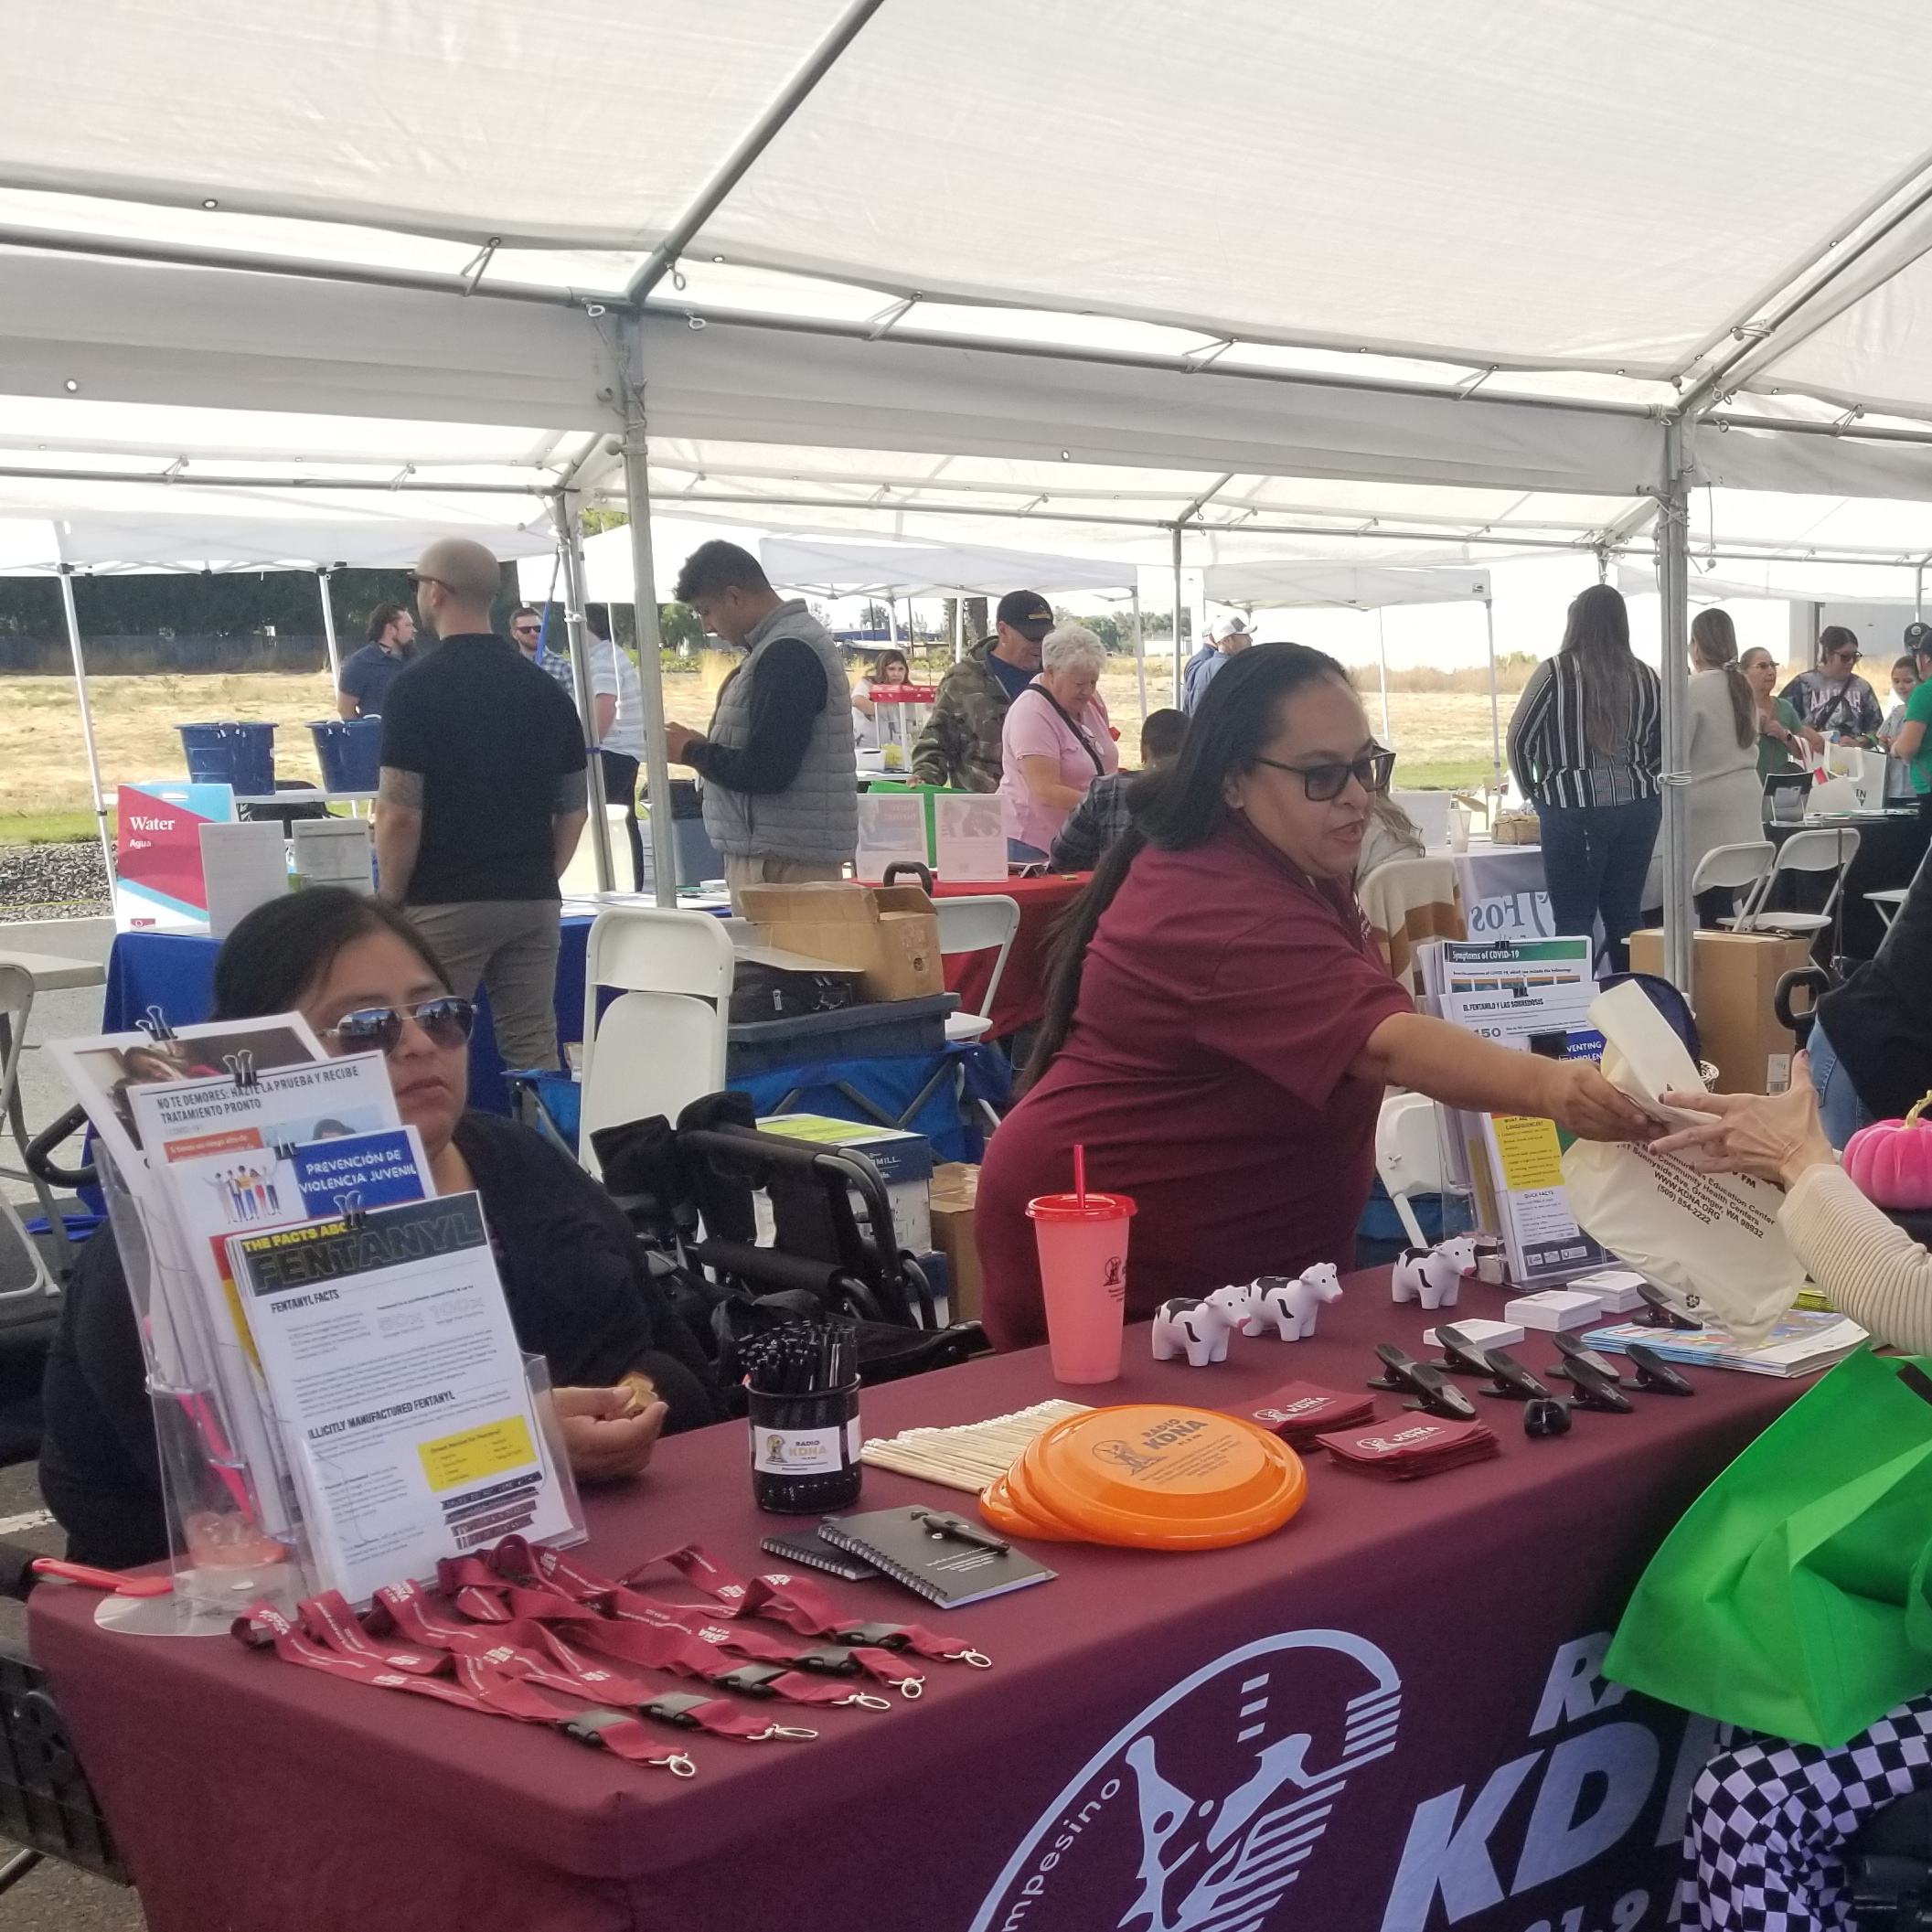
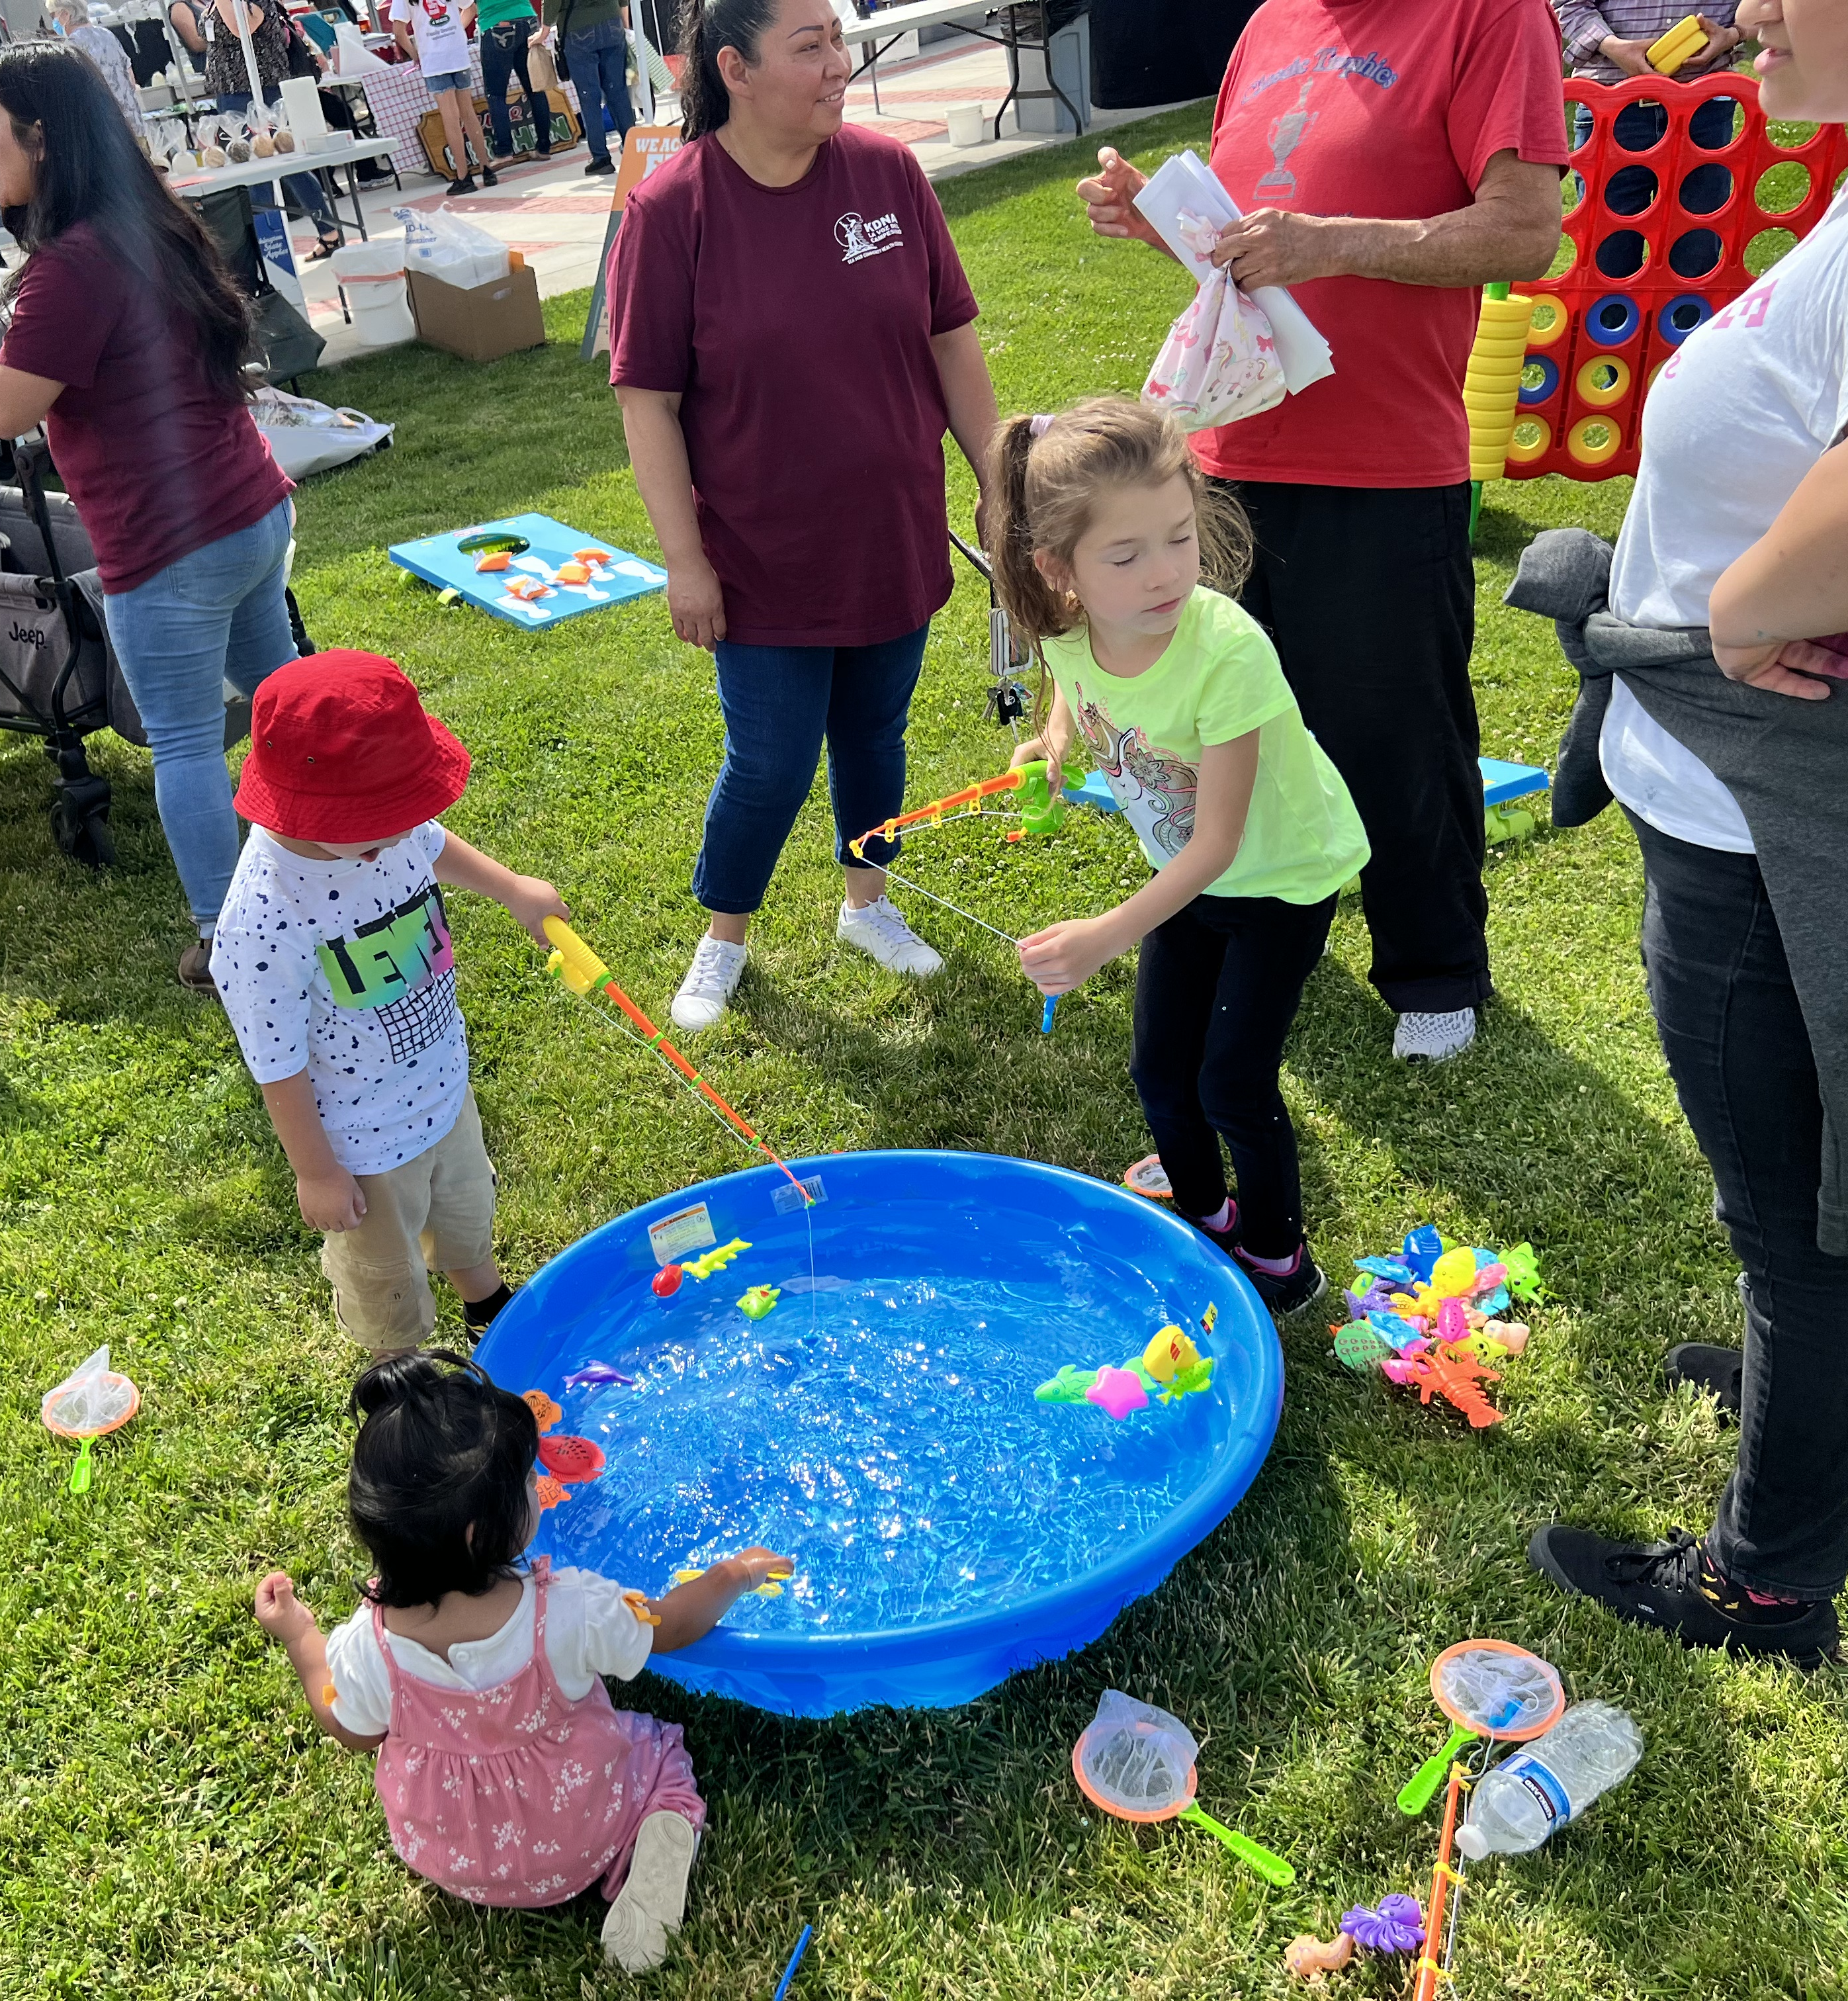
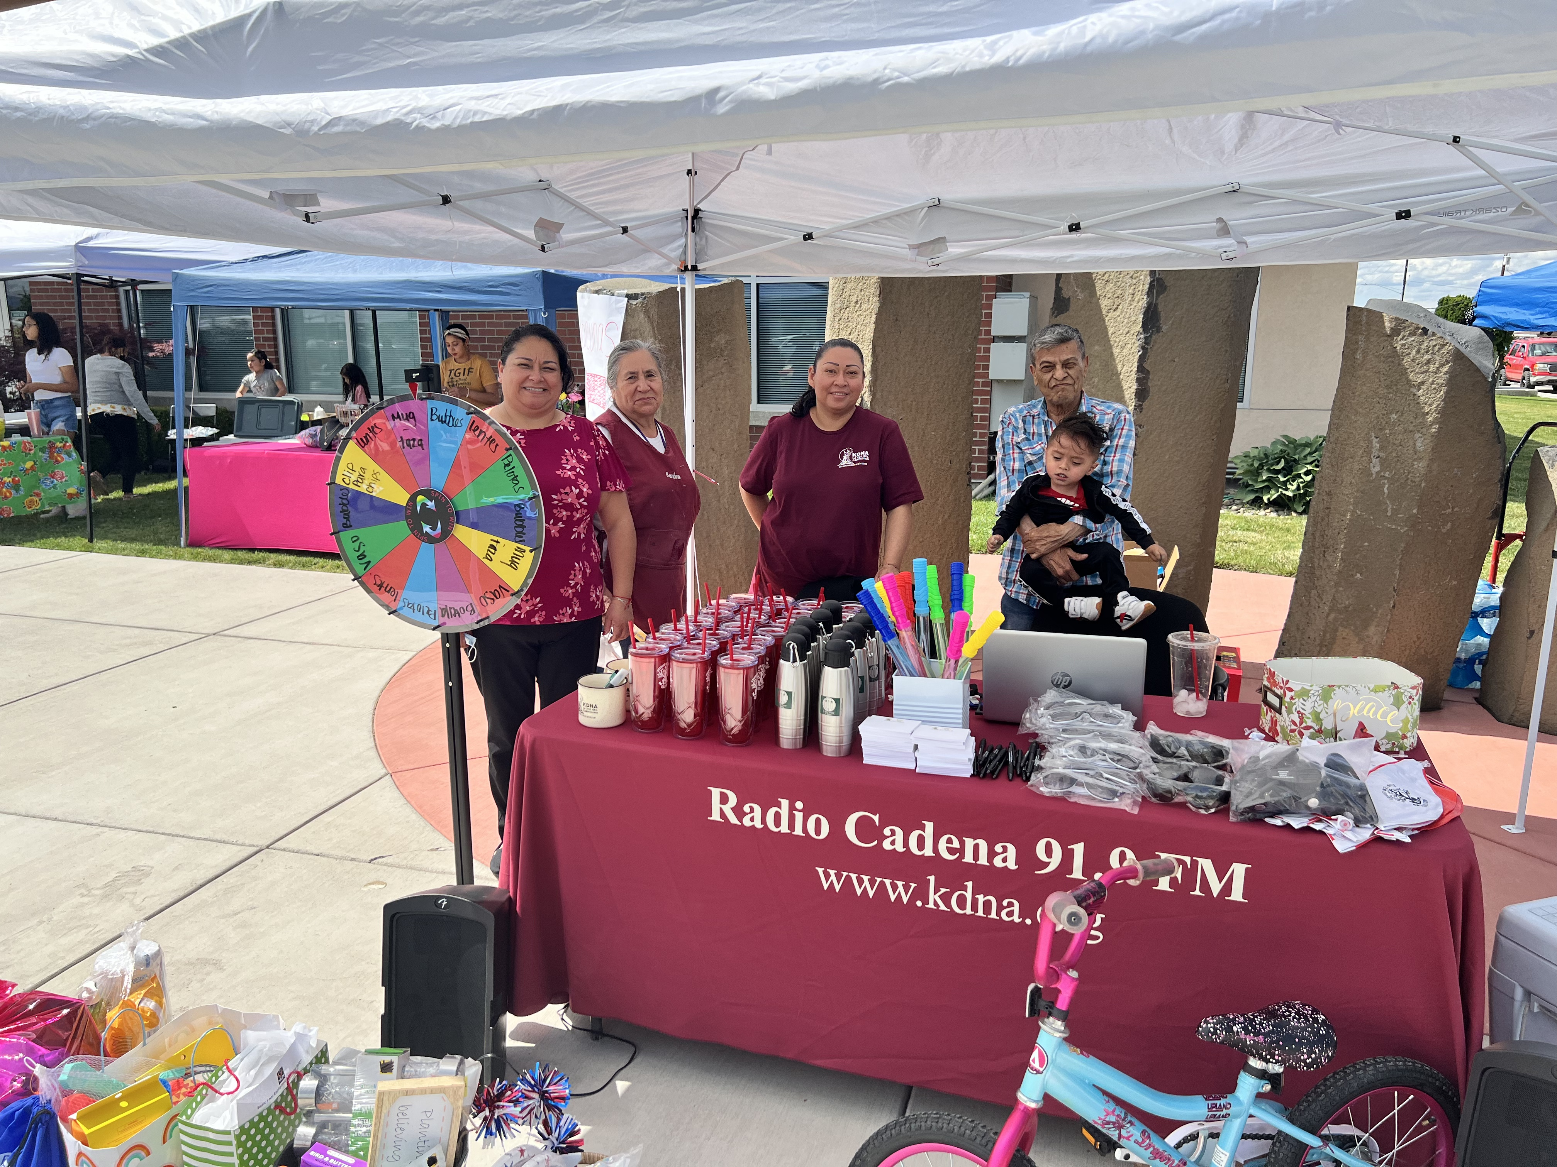
Opioids Outreach
Hosted one conference
Hosted webinars
Started asocial media campaign
Drive through resource fairs
Develop 4 different presentations for parents
Partner with key people to host youth presentations
Develop a Fotonovela
Notes:
When we started
Hosted one conference
Covid hit had to ajust to host -Hosted webinars -
Started asocial media campaign
Drive through resource fairs
Develop 4 different presentations for parents
Partner with key people to host youth presentations
Develop a Fotonovela

Slide 13
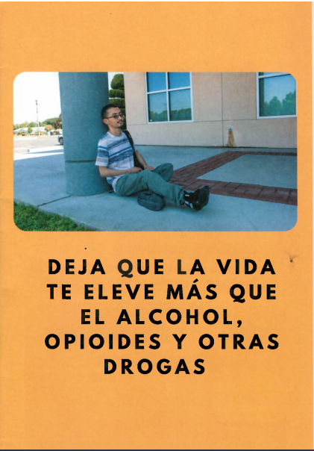
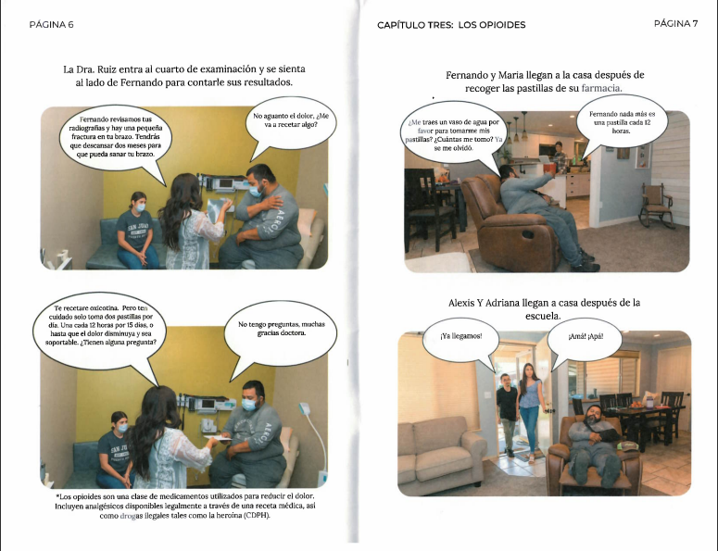
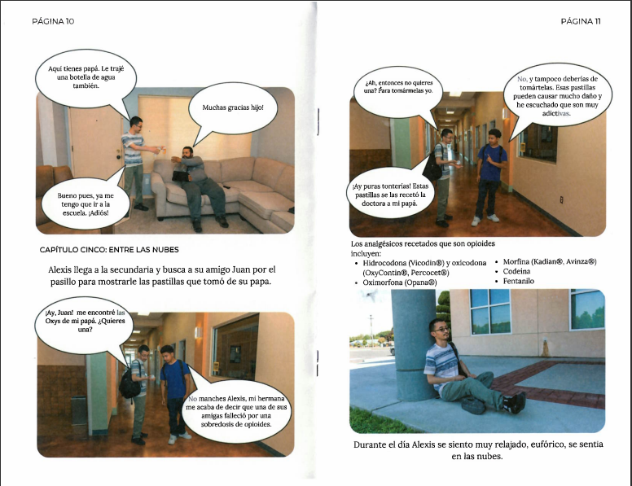
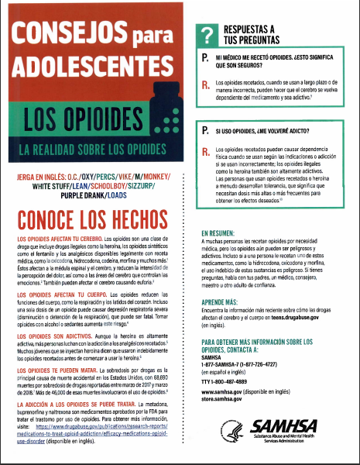
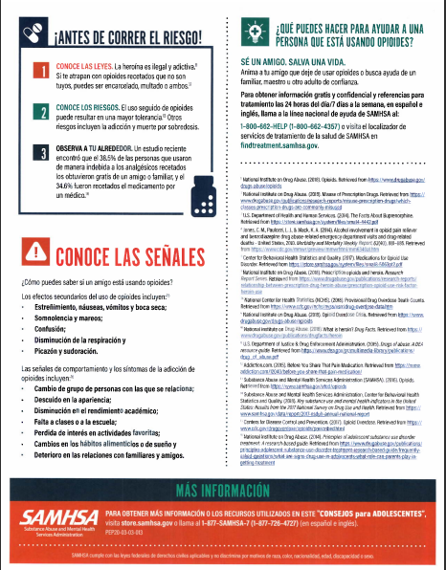
Print materials

Slide 14
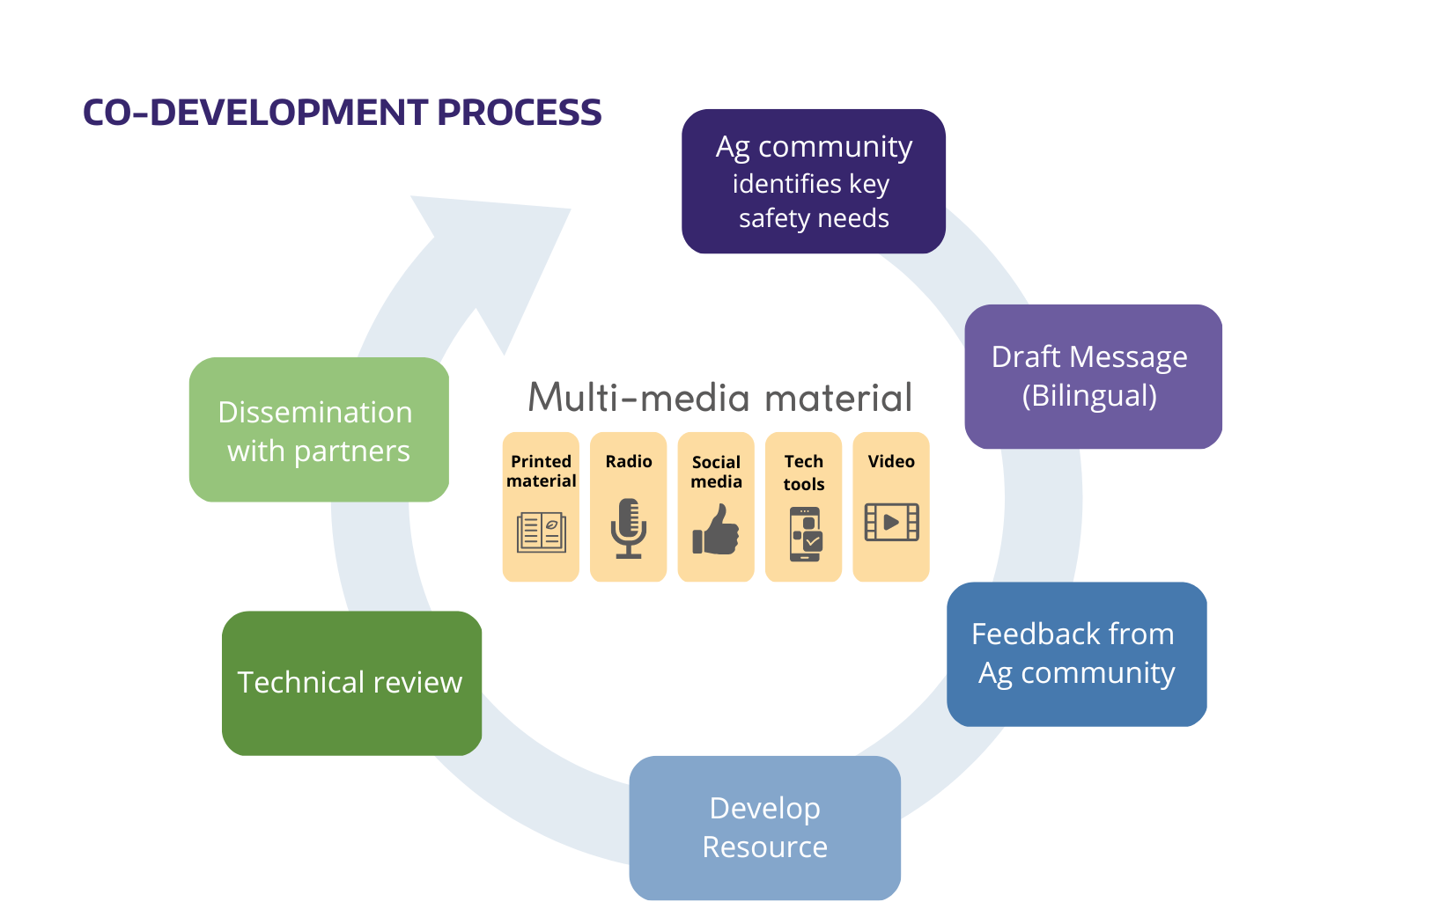
Notes:
We aim to produce easy-to-understand materials in Spanish and English. A lot of that can seem simple on the surface, but there's so much work that goes into the iterative process of reviewing and changing materials based on partner feedback. Since the early days of the pandemic, our team meets frequently with community organizations, industry organizations, state agencies, and academics. Often, our partners are bilingual and bicultural. This work would be impossible without those special people. These partnerships are really, really important to us and to the process. When many of us were forced online, we built capacity through the co-development process.
This process helps the outreach core stay focused on two key areas:
(1) returning research results with participants, partners, and the public; and
(2) sustaining opportunities that empower organizations to adapt our safety and health resources for their own communities
We want to meet people where they are at and where this work is already being done. As an institution, we need to practice cultural humility and recognize that it is our work to amplify others' work.
- Communities members share topics where ag workers need information
- Work together to communicate health and safety information
- We share messages technical reviews
- Develop multi-media message
- Final review from partners
- All partners leverage their channels and contacts to distribute this information to workers.
In total, about 25 products have been co-developed using this the process shown here. Main audiences were workers and employers.
Give overview sarah/idanis work
-COVID-19 topic inputs were typically ideas from community-based organizations or complex regulatory documents.
-Draft bilingual message in the cloud, send for information review by scientific experts
-Draft visually relatable and accurate multi-media material and send for feedback among UW and community groups
-Disseminate – radio spots, printed material (with masks), and electronically (post to website, share through social media)

Slide 15
Translation Process
Technical Document
Message/Content Table
Final Product

Slide 16
Narcan Training
What are opioids?
Opioid is the proper term, but opioid drugs may also be called opiates, painkillers, or narcotics. Opioids are a class of drugs commonly used to reduce pain. Opioids can be highly addictive and can lead to overdose if used in high amounts.
Notes:
When we talk about Narcan/Naloxone it is important to know first
What are opioids?
Opioid is the proper term, but opioid drugs may also be called opiates, painkillers, or narcotics.
Opioids are a class of drugs commonly used to reduce pain. Opioids can be highly addictive and can lead to overdose if used in high amounts.
Examples of opioids include heroin, fentanyl, oxycodone (OxyContin®), hydrocodone (Vicodin®), codeine, and morphine.

Slide 17
What is an overdose?
An opioid overdose occurs when too much of the drug overwhelms the brain and interrupts the body’s natural drive to breathe. During an overdose, breathing can be dangerously slowed or stopped, causing brain damage or death. It’s important to recognize the signs and act fast.
Signs of an overdose may include:
Small, constricted “pinpoint pupils”
Falling asleep or loss of consciousness
Slow, shallow breathing Choking or gurgling sounds
Limp body Pale, blue, or cold skin
Notes:
It is important to recognize the signs of an opioid overdose and how to revers the overdose
An opioid overdose occurs when too much of the drug overwhelms the brain and interrupts the body’s natural drive to breathe. During an overdose, breathing can be dangerously slowed or stopped, causing brain damage or death. It’s important to recognize the signs and act fast.
Signs of an overdose may include:
Small, constricted “pinpoint pupils”
Falling asleep or loss of consciousness
Slow, shallow breathing Choking or gurgling sounds
Limp body Pale, blue, or cold skin
unconsciousness
vomiting
an inability to speak
pale skin
purple lips and fingernails

Slide 18
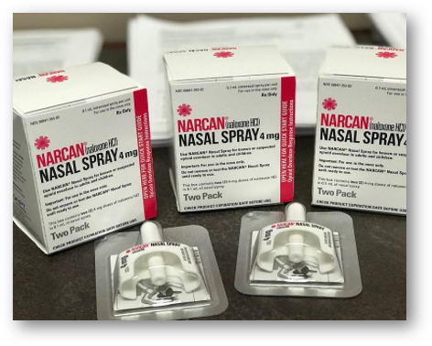
What is Naloxone/Narcan?
Naloxone is a safe medication that temporarily stops the effect of opioids. This helps a person start to breathe again and wake up from an opioid overdose.
Notes:
Naloxone is a medicine that rapidly reverses an opioid overdose. It is an opioid antagonist.
Naloxone comes in two FDA-approved forms: injectable and prepackaged nasal spray.

Slide 19
How does naloxone work?
Naloxone reverses an opioid overdose by blocking the opioid receptors in the brain.
This is a temporary effect and can last between 30 and 90 minutes. After giving someone naloxone, it may take a few minutes to work.
If a first dose of naloxone does not work after 3 minutes, give a second dose.
Notes:
This means that it attaches to opioid receptors and reverses and blocks the effects of other opioids.
Naloxone can quickly restore normal breathing to a person if their breathing has slowed or stopped because of an opioid overdose.
But, naloxone has no effect on someone who does not have opioids in their system, and it is not a treatment for opioid use disorder.

Slide 20
How does one use Naloxone on someone?​
Step 1​
Get their attention​
Step 2​
Call 911​​
Step 3​
Administer Naloxone​
Peel back package to device​
Place tip in nostril​
Press plunger firmly​​
Step 4​
Tilt head back to support breathing ​
Wait 1-3 minutes ​
Give second dose as needed​
Care for person until help arrives

Slide 21
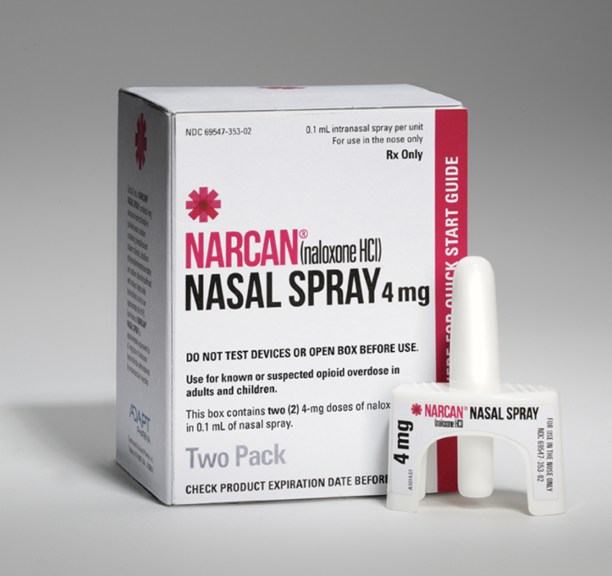
WHERE TO GET NALOXONE​
Pharmacies​
Community organizations​
Mail order​
https://adai.uw.edu/get-free-naloxone-by-mail-in-wa-state/ ​
Naloxone Vending Machines

Slide 22
Best Practices for Opioid Awareness: Radio and Outreach Campaigns
Elizabeth Torres, Director of Operations
etorres@kdna.org
Salvador Delgadillo, Program Coordinator
sdelgadillo@kdna.org

